Slide 1
Prediction of Percentage of Failed Surfaces for Wash WCs
HengKai (930233)

Slide 2
Overview
Project Goal
Features Used
Features Preparation
Machine Learning
Results
Conclusion

Slide 3
1.1 Project Goal
Predict percentage of failed surfaces in each wash wc using past data
Features
(Input variables)
ML Model
Label
(Predicted variable)
Data collected from Mon to Fri
Wash sensor values
Weather data
Num of surface
Percentage of failed surface
Predicted value for Sat
Percentage of failed surface

Slide 4
1.2 Project Goal: Assumptions
Past wash sensor values have an impact on number of failed surfaces in the future.

Slide 5
2.1 Features used
Used data between 2020-12-11 and 2021-03-11 for model training
Dataset | Features
CIM_TA_EC@1088411 | magd remark
gold.wash_kpiv_v1 (wash sensor data) | di_recirc_flow (no. anomalies) mst1_flow (no. anomalies) mst2_flow (no. anomalies) cs_osr_flow (mean)
Data.gov (Weather data) | no2 (mean)

Slide 6
2.2 Feature selection process
To determine the type of aggregate function to apply on the sensor values after grouping them by wc and date, the following aggregate functions are tested:
Anomaly count (using isolation forest)
Mean of standardized sensor values
Mean of sensor values
To determine the which weather data to use, the following weather data are tested:
o3, co, no2, so2

Slide 7
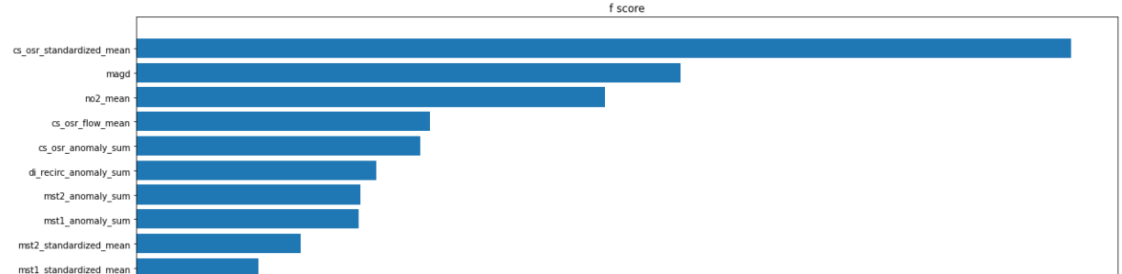
2.3 Test used to select features
Scikit-Learn’s f regression test is used
Tests whether any of the independent feature in a multiple linear regression model are significant
Higher value = more significant
Top 10 features based on f-test score

Slide 8
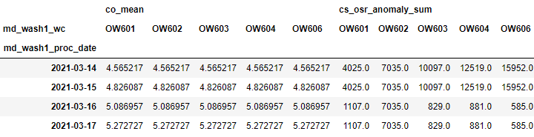
3.1 Features preparation (1)
Group values by WC & Features
Only keep columns with less than 30% NaN data
Split dataset into train and test dataset
Train dataset is used to train the machine learning model
Test dataset is used to test the machine learning model

Slide 9
3.2 Features preparation (2)
Applying rolling mean to train dataset
Apply Min Max scaling (0-1) to train dataset
Normalizes dataset
Ensures that all features will contribute to the model equally.
Min Max scaler fitted on train dataset is saved and later used to transform test dataset.

Slide 10
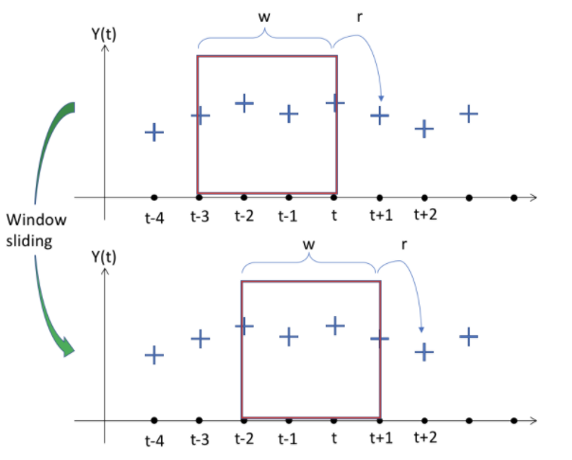
3.3 Features preparation (3)
Data windowing of datasets
Use values from previous time steps as features
Use values from next time step as label
An example of data windowing
w : window size
r : label we want to predict
t : time
values in red box : features used

Slide 11
4. Machine Learning
Model used : Deep Neural Network
The DNN used in this project is made up of:
Convolution neural network (feature extraction)
Recurrent neural network (pattern recognition)
Performance of the model is evaluated using Mean Area Error (MAE)

Slide 12
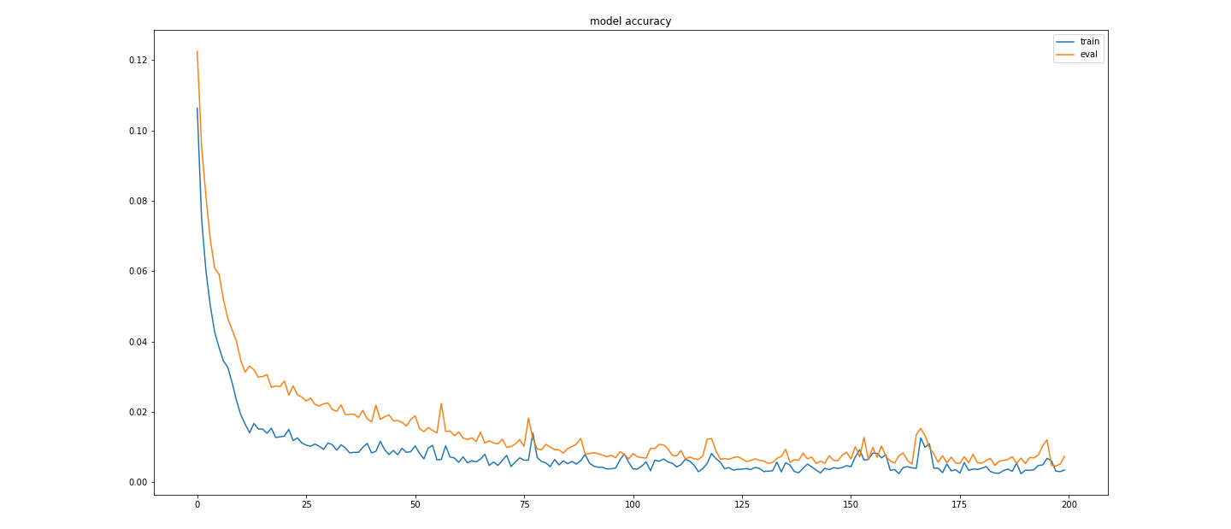
4.1 Training loss
Loss shows far the predicted values deviate from the actual values in the training data

Slide 13
5.1 Results
Model is used to predict the failure rate for 5 different wash WCs for 2021-03-17.
Data from 2021-03-14 to 2021-03-16 are inputted into the model.
Model achieved a mean MAE of 0.0027

Slide 14
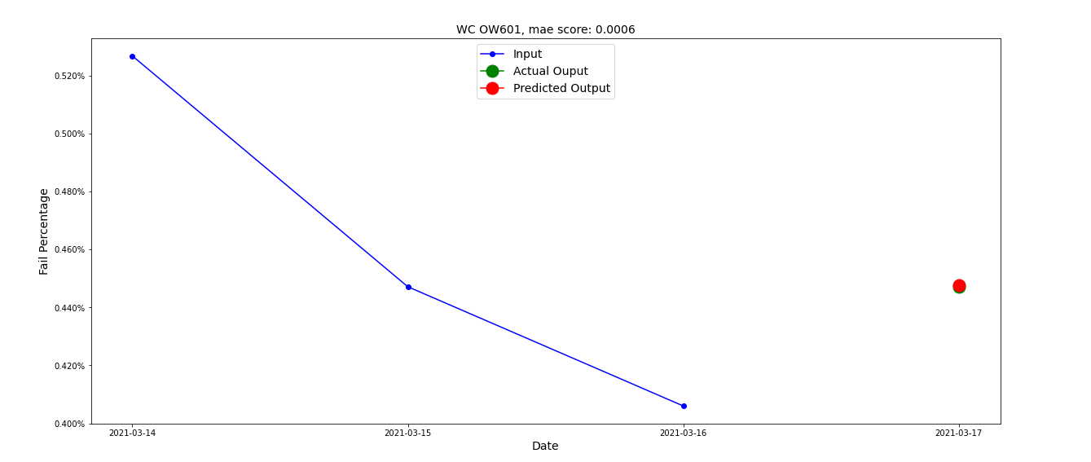
5.2 Results visualized (OW601)

Slide 15
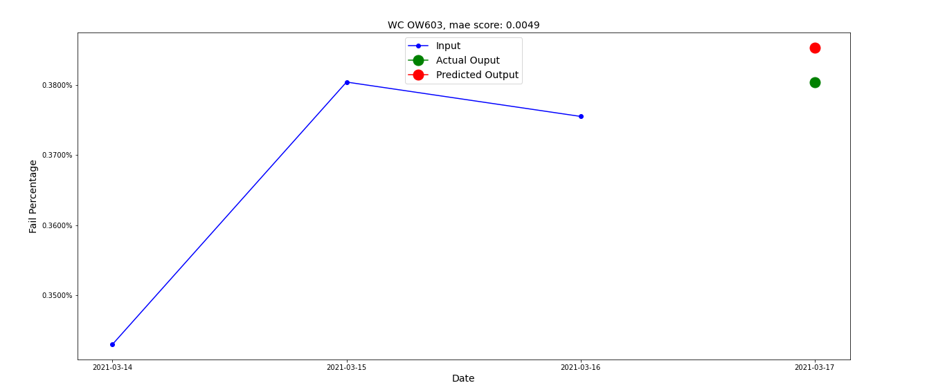
5.3 Results visualized (OW603)

Slide 16
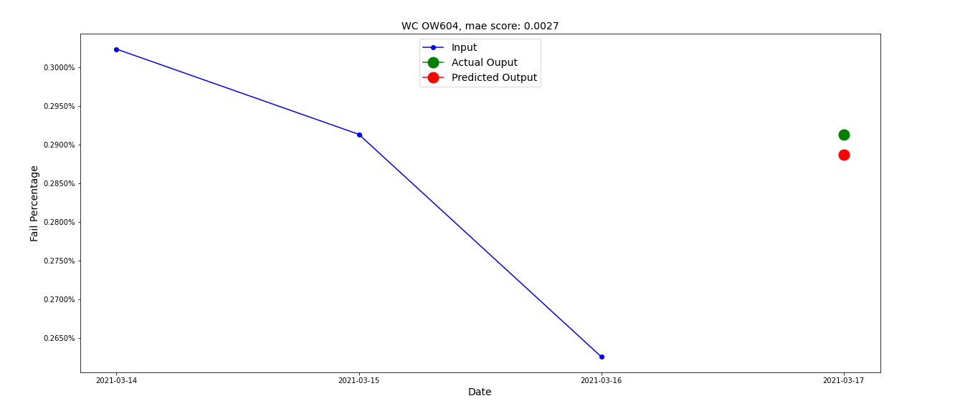
5.5 Results visualized (OW604)

Slide 17
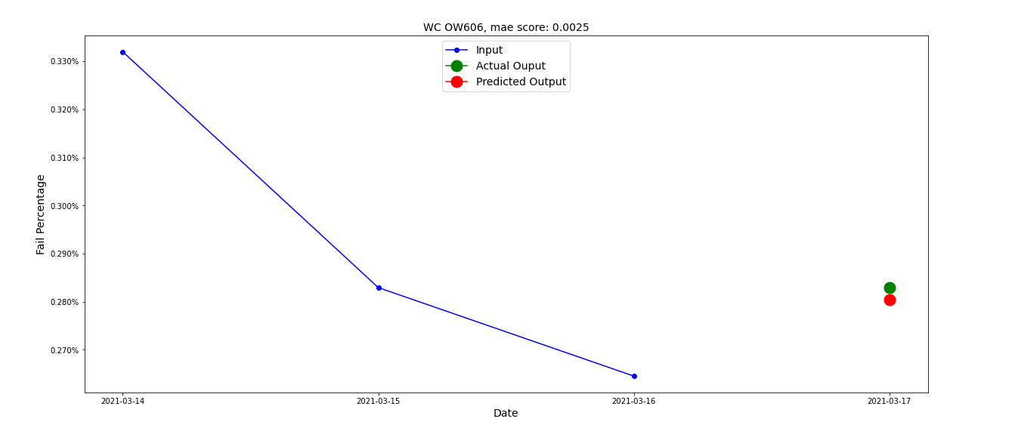
5.6 Results visualized (OW606)

Slide 18
6.1 Conclusion: further improvements
Expand model to predict other WCs (sputter, uv, etc.)
Explore and test other types of machine learning models
Automation of feature preparation and model training process
E.g. Retrain model every 2-4 weeks
Deploy model into production to predict failure rates in machines

Slide 19
6.2 Conclusion: final thoughts
Feature preparation and feature selection are the 2 most important steps in any machine learning process.
They will take up the most time
But with good feature preparation and selection, we can achieve high accuracy without a complex ml model
A lot more challenging when working with real world data.
Must find solution for missing data, work around data and server constraints
Overall an interesting project that allowed me to improve my Python & SQL skills and I also gained a deeper understanding of timeseries machine learning.

